Slide 1
HR Department Overview
2025 Employee Programs & Benefits
Human Resources

Slide 2

Workforce Demographics
Workforce comprises 1,000 dedicated employees
Sales team accounts for 200 representatives
Average employee tenure is 3.2 years
Employee satisfaction rating is an impressive 87%

Slide 3
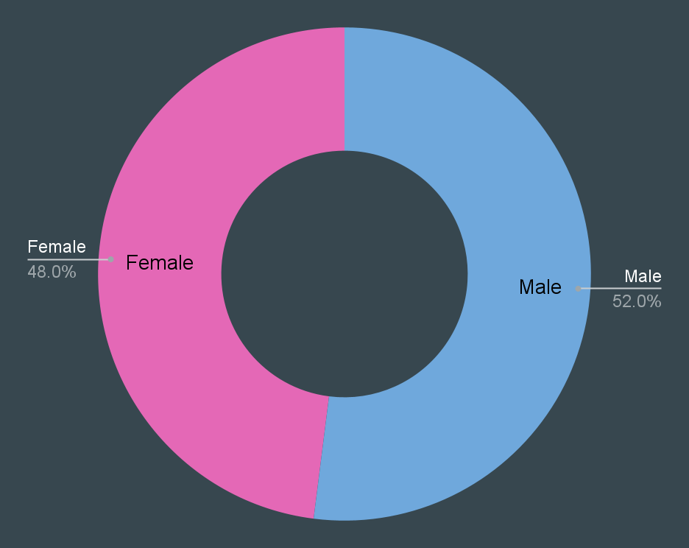

Gender Distribution
Workforce gender split is nearly even
Males represent 52% of total employees
Females account for 48% of the workforce

Slide 4

Future HR Goals
Expanding professional development opportunities
Enhancing employee wellness programs
Implementing new HR technology solutions
Fostering a more diverse and inclusive workplace

Slide 5
Benefits Program Utilization
High Engagement Programs
• 401(k) Participation: 95%
• Health Insurance Enrollment: 98%
• Professional Development: 78% participated
• Fitness Reimbursement: 45% usage

Slide 6
Professional Development Results
Investment in Employee Growth
• Total Training Hours: 12,000
• Certifications Earned: 156
• Internal Promotions: 45
• Employee Retention: 92%

Slide 7
Employee Wellness Initiatives
Supporting Work-Life Balance
• Remote Work Adoption: 65%
• Mental Health Support: 89% awareness
• Parental Leave: 12 weeks paid
• Flexible Schedule: 70% participation

Slide 8

Key Takeaways & Next Steps
HR programs focus on employee growth and well-being.
High participation in benefits and development programs.
Strong employee satisfaction and retention rates.
Company supports work-life balance initiatives.

